Slide 1
Virtual education space for lifelong learning
vladimir valkanov
Faculty of mathematics and informatics
Plovdiv university

Slide 2
Goals & HISTORY
Main goal: supporting e-learning process by delivering e-services and teaching content.
DeLC architecture: distributed system, containing fixed and mobile nodes.
Fixed node: campus wired network.
Mobile node: providing mobile access to the services, through intelligent wireless network based on advanced InfoStation architecture.

Slide 3
Infrastructure of DeLC

Slide 4
From delc to ves
New tendency in the development of Internet and Web:
Internet of Things – stimulating the origin of cyber-physical systems which will lead to essential consequences in the fallowing years.
Semantic web.
Develop VES with the following features:
Intelligent.
Context-aware.
Scenario-oriented.
Controlled infrastructure.
Lifelong learning support

Slide 5
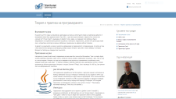
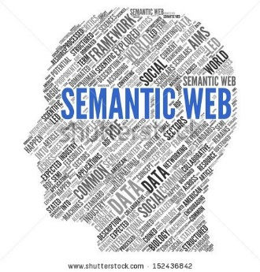
virtual education space
Self-Paced Learning
Gard
DiLibs
Operative
Personal Assistant
Common Cartridge (QTI 2.1)
Admin
Blended learning
VES in more details: Building a Virtual Education Space, WMSCI 2015, July 12 - 15 - Orlando, Florida, USA

Slide 6
Virtual education space
SPA
SCORM Engine
Test
Engine
Event
Engine
DiLibs
Network analysis, Biometry
Guards
TPA
Admin
System services:
Focus
E-mail
Project management
Eduroam
…

Slide 7
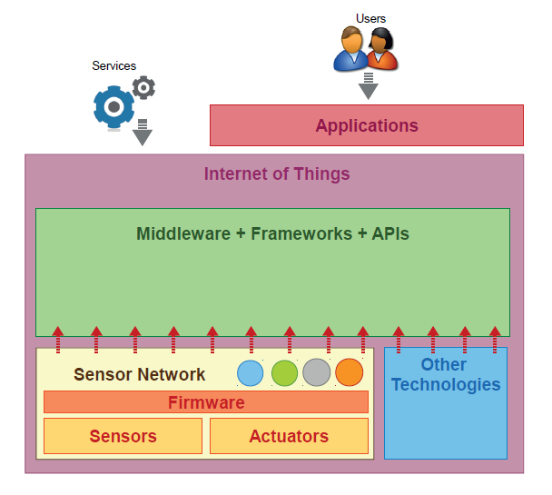
Iot infrastructure
IoT is not focused on a concrete application
It is developed to deliver generic services and properties like intelligence, context-awareness …
IoT cannot exist without SN
SN can exist without IoT
[C. Perera et al. Context Aware Computing for The Internet of Things: A Survey]

Slide 8
VES as iot
DiLibs
Admin
Sensor level: what information would we collect?
Standards - SCORM 2004, CC (QTI);
Network infrastructure;
Information resources location;

Slide 9
VES as iot
DiLibs
Analysis level: developing models for operation of VES
Students results
Teaching/Learning effectiveness
Planning and organizing educational process
Admin
Sensor level: what information would we collect?
Standards - SCORM 2004, CC (QTI);
Network infrastructure;
Information resources location;

Slide 10
VES as iot
Access points:
Personal assistant
Educational portal
DiLibs
Analysis level: developing models for operation of VES
Students results
Teaching/Learning effectiveness
Planning and organizing educational process
Admin
Sensor level: what information would we collect?
Standards - SCORM 2004, CC (QTI);
Network infrastructure;
Information resources location;

Slide 11
Lifelong learning
Operational Programm “Research and Education”
adopted by the European Commission
“Provide accessible and quality education for personal development through modernization the education system and ensure its adaptability to needs of the labor market” (Lifelong learning)
Model for implementation of Lifelong Learning by Virtual Education Space

Slide 12
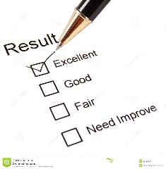
Lifelong learning model
Problem-oriented
Preview
Digital Library
Teaching material
Test Questions
Patterns (Courses, Tests, …)
Meta Data
Personalized Courses
Grant No. IT15-HF-001 “Improving the access to educational services in the context of Lifelong Learning”, 2015-2016

Slide 13
Agents’ support
Problem-oriented
Preview
Generic PA
Digital Library
DiLib Operatives
Personalized Courses
PAs

Slide 14
Robotics (preview)

Slide 15
Development environment
Education Portal
Java, Groovy, Grails
Intelligent Agents
JADE, JADEX
Ontologies
Protégé
Mobile devices
Android

Slide 16
Under construction
Standards Extension
Common Cartridge (Grady Book)
Space adaptation for Lifelong Learning
Personal Assistants - bounded rational agents with BDI-architecture
DiLib Operatives
Guards

Slide 17
Thank you for your attention!

